Slide 1
Topic: Percentage of an Amount EQ: How do I calculate a percentage of an amount?
Year 11 Essentials

Slide 2
Things Required For This Lesson
Interactive Notebook
Textbook: Interleaved Maths Essential Connections
Ruler, Red Pen, Pencil, Pens, Scientific Calculator
Growth mindset

Slide 3

24
7
30
Topic: Percentage of an Amount
Date: /03/2021
EQ: How do I calculate a percentage of an amount?
WICOR
This Photo by Unknown Author is licensed under CC BY-SA

Slide 4
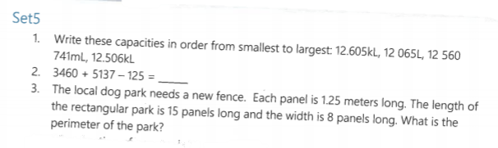
Topic: Percentage of an Amount
EQ: How do I calculate a percentage of an amount?

Slide 5
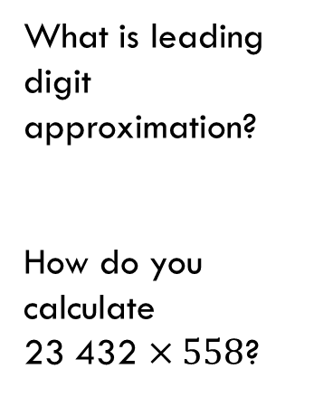
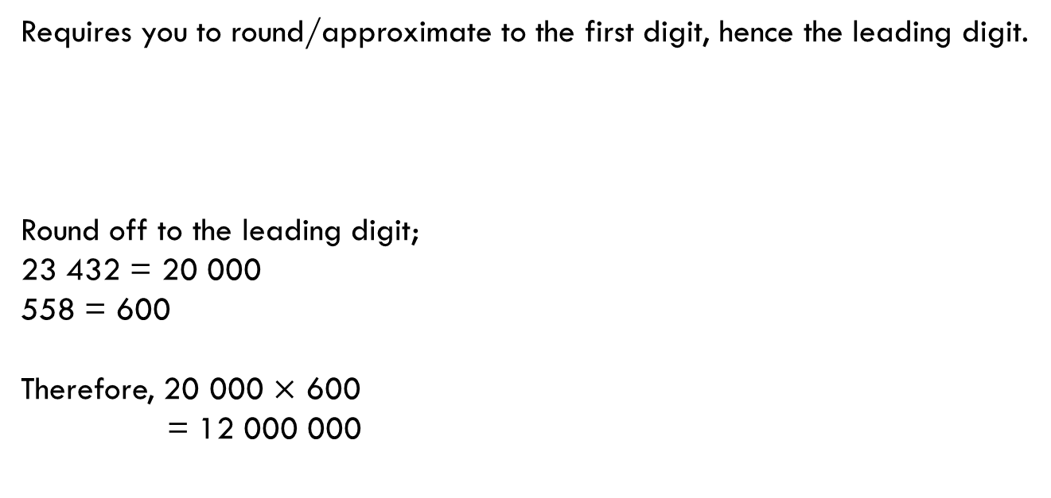
24
7
30
Topic: Percentage of an Amount
EQ: How do I calculate a percentage of an amount?
What is leading digit approximation?
How do you calculate
23 432 $×558$?
Requires you to round/approximate to the first digit, hence the leading digit.
Round off to the leading digit;
23 432 = 20 000
558 = 600
Therefore, 20 000 $×$ 600
= 12 000 000
WICOR

Slide 6

Practice: Approximation using leading digits (LHS)
$35 ×467=$
$784 ÷23=$
$467 ×32+12.6=$

Slide 7

24
7
30
Topic: Percentage of an Amount
EQ: How do I calculate a percentage of an amount?
Turning a percentage into a decimal
What does of mean? E.g. 30% of 40
Find 10% of 30
If you are given 75%, to turn it into a decimal you must divide by 100 to give you 0.75
‘Of’ means to multiply
1. Turn the percentage to a decimal
10% $÷100$ = 0.1
2. Multiply the decimal and the amount
0.1 $×$ 30
= 3
WICOR

Slide 8

Practice: (LHS)
$5\% of 35=$
$60\% of 84=$
$75\% of 135=$
$85\% of 5=$

Slide 9
Practice: Complete SET A-d ON PAGE 27 & Set A on Page 18

Slide 10
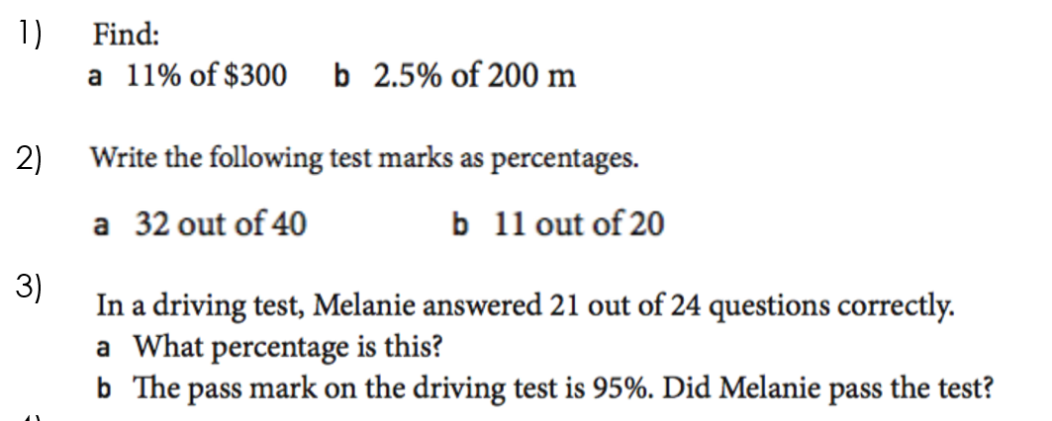
EXIT Pass

Slide 11

Thank you
Keep up the good work!
"Success is no accident. It is hard work, perseverance, learning, studying, sacrifice and most of all, love of what you are doing or learning to do.“
-PELE

